Slide 1
Timber technology

Slide 2
Characteristics
Assembly of different components using special joints for each element , nearly always avoiding the use of fixing devices made from materials other than wood –
Easy repair operations, deteriorated components need to be replaced.

Slide 3
Roofing- temples
A steep roof pitch and large overhanging eaves – climatic conditions – monsoon rains and extreme exposure to sun.

Slide 4
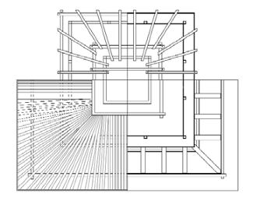
Roofing- temples
Temple roofs have symmetrical pitches springing from the central point of the cell consisting of central post (tha).
Fig : - Biswonath Temple-Patan (courtesy: - Bonapace, C. & Sestini, V. (2003)

Slide 5
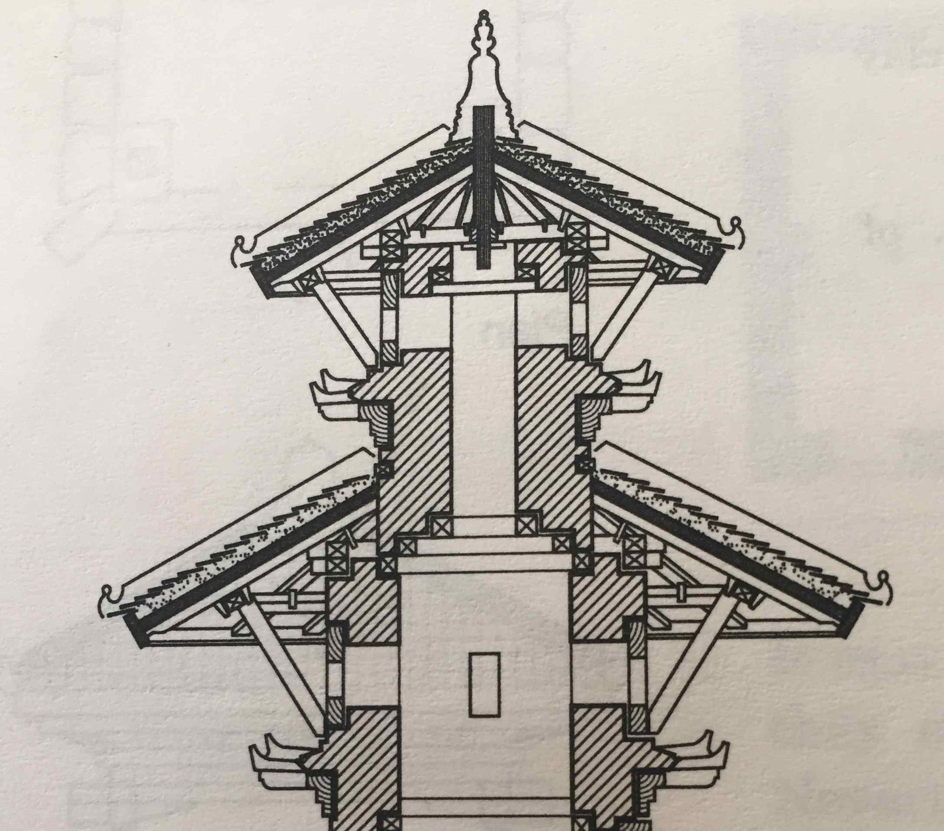
Roofing- temples
Temple roofs have symmetrical pitches springing from the central point of the cell consisting of central post (tha).
Fig : - Narayan Temple-Patan (courtesy: - Korn, W. (1976)

Slide 6
Roofing-temples
Ridge piece (dhuri) rests on a row of simple vertical posts (dhuri thas).
Wallplates (nas) rest on low sleeper walls that are an extension of lower wall structure, now enclosed in the roof space and the roof plate (nas)
Outer side – large overhang supported by an eaves beam which in turn is supported by carved wooden struts (tunasi).
On the inner side rafters are anchored to a tie beam fixed to the walls – elements joined using wooden wedges (chukus).

Slide 7
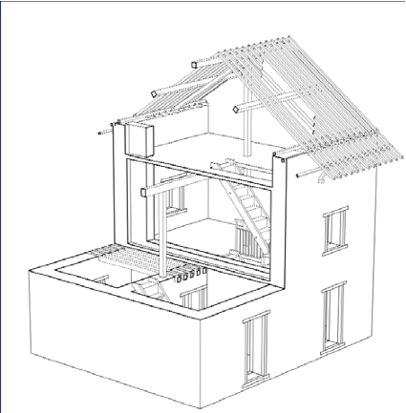
Roofing-home
Two steep pitches 40 – 50 degrees- full use of space.
Fig: - Axonometric View of a Newar House (courtesy: - Bonapace, C. & Sestini, V. (2003)

Slide 8
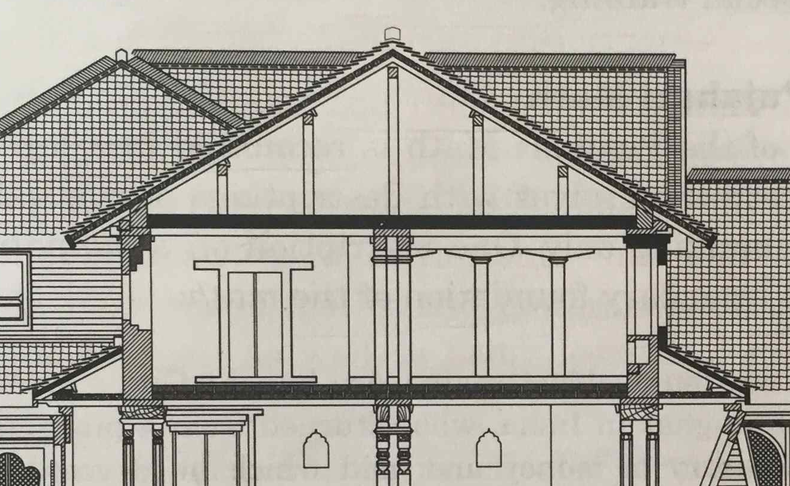
Roofing-home
Ridge beam rests on central pillar and on the lateral gable walls to form the structure.
Fig: - Section of Pujari math –Bhaktapur with primary rafters resting on pillar
(courtesy : - Korn, W. 1976)

Slide 9
Roofing-home
Ridge beam rests on central pillar and on the lateral gable walls to form the structure.
Two principal rafters tied up to the central pillar, leading against the lateral wall on a wooden plate which transforms the thrust to the walls.
Fig: - Axonometric View of a Newar House with primary rafters and gable walls structure (courtesy: - Bonapace, C. & Sestini, V. (2003)

Slide 10
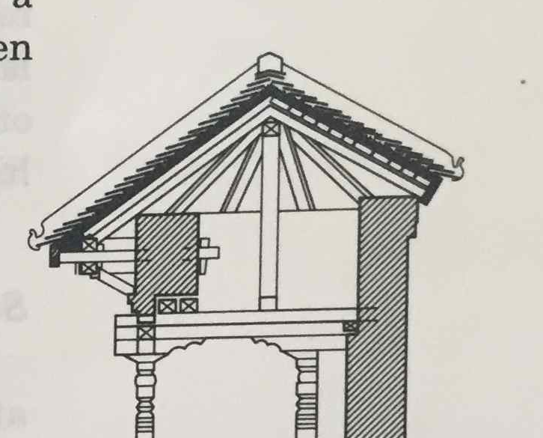
Roofing-home
Purlins rest on the principal rafters and secondary rafters rest on these purlins following the slope of the roof- extends beyond the wall to form the overhanging eaves.
Fig: - Section of pati at Saugal with purlins and roof
(courtesy : - Korn, W. 1976)

Slide 11
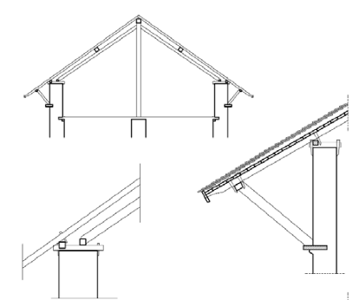
Roofing-home
Two ways of overhanging structure -1) provides support to the secondary rafters via an eaves plate fixed parallel to wall and supported by series of secondary struts.
Fig: - Overhanging eaves & Struts (tunasi) Type 1 (courtesy: -Bonapace, C. & Sestini, V. (2003)

Slide 12
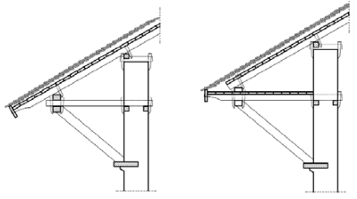
Roofing-home
2) some extra tie beams inserted to provide additional support to the eaves.
Wooden elements held together by wooden wedges
Fig: - Overhanging eaves & Struts Type 2 (courtesy: -Bonapace, C. & Sestini, V. (2003)

Slide 13
Reading Material
Korn, W. (1976). Th Traditional Architecture of Kathmandu valley, Kathmandu, Ratna Pustak Bhandar
Bonapace, C. & Sestini, V. (2003) Traditional Materials and Construction Technologies used in the Kathmandu Valley, UNESCO, Lalitpur

